Slide 1
GSM

Slide 2
GSM: Overview
GSM stands for Global System for Mobile Communication.
It is a digital cellular technology used for transmitting mobile voice and data services.
The concept of GSM emerged from a cell-based mobile radio system at Bell Laboratories in the early 1970s.
GSM is the name of a standardization group established in 1982 to create a common European mobile telephone standard.
GSM is the most widely accepted standard in telecommunications and it is implemented globally.
GSM is a circuit-switched system that divides each 200 kHz channel into eight 25 kHz time-slots. GSM operates on the mobile communication bands 900 MHz and 1800 MHz in most parts of the world. In the US, GSM operates in the bands 850 MHz and 1900 MHz.

Slide 3
GSM: Overview
GSM owns a market share of more than 70 percent of the world's digital cellular subscribers.
GSM makes use of narrowband Time Division Multiple Access (TDMA) technique for transmitting signals.
GSM was developed using digital technology. It has an ability to carry 64 kbps to 120 Mbps of data rates.
Presently GSM supports more than one billion mobile subscribers in more than 210 countries throughout the world.
GSM provides basic to advanced voice and data services including roaming service. Roaming is the ability to use your GSM phone number in another GSM network.

Slide 4
GSM: Overview
Features of GSM that account for its popularity and wide acceptance.
Improved spectrum efficiency
International roaming
Low-cost mobile sets and base stations (BSs)
High-quality speech
Compatibility with Integrated Services Digital Network (ISDN) and other telephone company services
Support for new services

Slide 5
Performance characteristics of GSM
Communication
  mobile, wireless digital communication; support for voice and data services
Total mobility
  international access, chip-card enables use of access points of different providers
Worldwide connectivity
  one number, the network handles localization
High capacity
  better frequency efficiency, smaller cells, more customers per cell
High transmission quality
  high audio quality
  uninterrupted phone calls at higher speeds (e.g., from cars, trains) – better handoffs and
Security functions
  access control, authentication via chip-card and PIN

Slide 6
Disadvantages of GSM
There is no perfect system!!
  no end-to-end encryption of user data
  no full ISDN bandwidth of 64 kbit/s to the user, no transparent B-channel
  abuse of private data possible
roaming profiles accessible
  high complexity of the system
  several incompatibilities within the GSM standards

Slide 7
GSM
GSM is the most successful digital mobile telecommunication system in the world today.
It is used by over 800 million people in more than 190 countries.
GSM permits the integration of different voice and data services and the interworking with existing networks.
Services make a network interesting for customers. GSM has defined three different categories of services:
  bearer,
  tele and
  supplementary services.

Slide 8
GSM - User Services
GSM offers much more than just voice telephony. Contact your local GSM network operator to the specific services that you can avail.
GSM offers three basic types of services:
  Telephony services or teleservices
  Data services or bearer services
  Supplementary services

Slide 9
GSM - User Services
Teleservices
The abilities of a Bearer Service are used by a Teleservice to transport data. These services are further transited in the following ways:
Voice Calls
The most basic Teleservice supported by GSM is telephony. This includes full-rate speech at 13 kbps and emergency calls, where the nearest emergency-service provider is notified by dialing three digits.

Slide 10
GSM - User Services
Short Text Messages
Short Messaging Service (SMS) service is a text messaging service that allows sending and receiving text messages on your GSM mobile phone. In addition to simple text messages, other text data including news, sports, financial, language, and location-based data can also be transmitted.

Slide 11
Bearer services
Data services or Bearer Services are used through a GSM phone. to receive and send data is the essential building block leading to widespread mobile Internet access and mobile data transfer.
GSM currently has a data transfer rate of 9.6k.
New developments that will push up data transfer rates for GSM users are HSCSD (high speed circuit switched data) and GPRS (general packet radio service) are now available.

Slide 12
Bearer services
GSM specifies different mechanisms for data transmission, the original GSM allowing for data rates of up to 9600 bit/s for non-voice services.
Bearer services permit transparent and non-transparent, synchronous or asynchronous data transmission.

Slide 13
Bearer services
Transparent bearer services only use the functions of the physical layer (layer 1) to transmit data.
Data transmission has a constant delay and throughput if no transmission errors occur.
Transmission quality can be improved with the use of forward error correction (FEC), which codes redundancy into the data stream and helps to reconstruct the original data in case of transmission errors.
Transparent bearer services do not try to recover lost data in case of, for example, shadowing or interruptions due to handover.

Slide 14
Bearer services
Non-transparent bearer services use protocols of layers two and three to implement error correction and flow control.
These services use the transparent bearer services, adding a radio link protocol (RLP).
This protocol comprises mechanisms of high-level data link control (HDLC), and special selective-reject mechanisms to trigger retransmission of erroneous data.

Slide 15
Bearer services
Using transparent and non-transparent services, GSM specifies several bearer services for interworking with PSTN, ISDN, and packet switched public data networks (PSPDN) like X.25, which is available worldwide. Data transmission can be full-duplex, synchronous with data rates of 1.2, 2.4, 4.8, and 9.6 kbit/s or full-duplex, asynchronous from 300 to 9,600 bit/s.

Slide 16
Tele services
GSM mainly focuses on voice-oriented tele services.
These comprise encrypted voice transmission, message services, and basic data communication with terminals as known from the PSTN or ISDN[Integrated Services Digital Network : is a set of communication standards for simultaneous digital transmission of voice, video, data and other network services over the traditional circuits of the public switched telephone network] (e.g., fax).
The primary goal of GSM was the provision of high-quality digital voice transmission.

Slide 17
Tele services
Special codecs (coder/decoder) are used for voice transmission, while other codecs are used for the transmission of analog data for communication with traditional computer modems used in, e.g., fax machines.
Another service offered by GSM is the emergency number (eg. 911, 999).
This service is mandatory for all providers and free of charge. This connection also has the highest priority, possibly pre-empting other connections, and will automatically be set up with the closest emergency centre.

Slide 18
Tele services
A useful service for very simple message transfer is the short message service (SMS), which offers transmission of messages of up to 160 characters.
Sending and receiving of “M“ is possible during data or voice transmission.
It can be used for “serious” applications such as displaying road conditions, e-mail headers or stock quotes, but it can also transfer logos, ring tones, horoscopes and letters.

Slide 19
Tele services
The successor of SMS, the enhanced message service (EMS), offers a larger message size, formatted text, and the transmission of animated pictures, small images and ring tones in a standardized way.
But with MMS, EMS was hardly used.
MMS offers the transmission of larger pictures (GIF, JPG, WBMP), short video clips etc. and comes with mobile phones that integrate small cameras.
Another non-voice tele service is group 3 fax, which is available worldwide.
In this service, fax data is transmitted as digital data over the analog telephone network according to the ITU-T standards T.4 and T.30 using modems.

Slide 20
Supplementary services
In addition to tele and bearer services, GSM providers can offer supplementary services.
These services offer various enhancements for the standard telephony service, and may vary from provider to provider.
Typical services are :
User identification, call redirection, or forwarding of ongoing calls, barring of incoming/outgoing calls, Advice of Charge (AoC) etc.
Standard ISDN features such as closed user groups and multiparty communication may be available.

Slide 21
GSM Architecture
A GSM system consists of three subsystems,
the radio sub system (RSS),
the network and switching subsystem (NSS), and
the operation subsystem (OSS).

Slide 22
GSM Architecture
A GSM network comprises of many functional units. The GSM network can be broadly divided into:
The Mobile Station (MS)
The Base Station Subsystem (BSS)
The Network Switching Subsystem (NSS)
The Operation Support Subsystem (OSS)
Given below is a simple pictorial view of the GSM architecture.

Slide 23
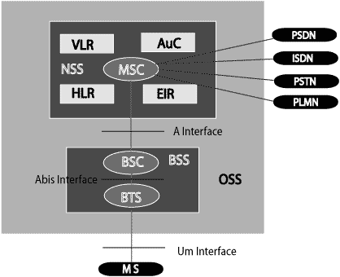
GSM Architecture

Slide 24
GSM Architecture
The additional components of the GSM architecture comprise of databases and messaging systems functions:
Home Location Register (HLR)
Visitor Location Register (VLR)
Equipment Identity Register (EIR)
Authentication Center (AuC)
SMS Serving Center (SMS SC)
Gateway MSC (GMSC)
Chargeback Center (CBC)
Transcoder and Adaptation Unit (TRAU)

Slide 25
GSM Architecture
AUC : Authentication Center BSC : Base Station Controller
BSS : Base Station Subsystem BTS : Base Transceiver Station
EIR : Equipment Identity Register GMSC: Gateway MSC
HLR : Home Location Register ISDN : Integrated Systems Digital Network
MS : Mobile Station MSC : Mobile Switching Center
OMC : Operation and Maintenance Center
PDN : Public Data Network GIWU : Gateway Interworking Unit
PSTN : Public Switched Telephone Network
SC : Service Centre/SMS Controller
VLR : Visitor Location Register

Slide 26
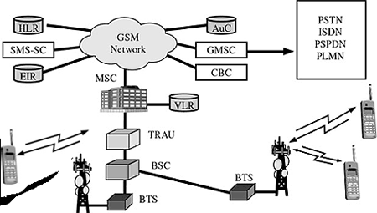
GSM Architecture
The following diagram shows the GSM network along with the added elements:

Slide 27
GSM: overview
OMC, EIR,
AUC
HLR
fixed network
GMSC
NSS
with OSS
VLR
MSC
VLR
MSC
BSC
BSC
RSS

Slide 28
GSM network areas
In a GSM network, the following areas are defined:
Cell : Cell is the basic service area; one BTS covers one cell. Each cell is given a Cell Global Identity (CGI), a number that uniquely identifies the cell.
Location Area : A group of cells form a Location Area (LA). This is the area that is paged when a subscriber gets an incoming call. Each LA is assigned a Location Area Identity (LAI). Each LA is served by one or more BSCs.
MSC/VLR Service Area : The area covered by one MSC is called the MSC/VLR service area.
PLMN : The area covered by one network operator is called the Public Land Mobile Network (PLMN). A PLMN can contain one or more MSCs.

Slide 29
GSM - Specification
The requirements for different Personal Communication Services (PCS) systems differ for each PCS network. Vital characteristics of the GSM specification are listed below:
Modulation
Modulation is the process of transforming the input data into a suitable format for the transmission medium. The transmitted data is demodulated back to its original form at the receiving end. The GSM uses Gaussian Minimum Shift Keying (GMSK) modulation method.

Slide 30
GSM - Specification
Access Methods
Radio spectrum being a limited resource that is consumed and divided among all the users, GSM devised a combination of TDMA/FDMA as the method to divide the bandwidth among the users. In this process, the FDMA part divides the frequency of the total 25 MHz bandwidth into 124 carrier frequencies of 200 kHz bandwidth.
Each BS is assigned with one or multiple frequencies, and each of this frequency is divided into eight timeslots using a TDMA scheme. Each of these slots are used for both transmission as well as reception of data. These slots are separated by time so that a mobile unit doesn’t transmit and receive data at the same time.

Slide 31
GSM - Specification
Transmission Rate
The total symbol rate for GSM at 1 bit per symbol in GMSK produces 270.833 K symbols/second. The gross transmission rate of a timeslot is 22.8 Kbps.
GSM is a digital system with an over-the-air bit rate of 270 kbps.
Frequency Band
The uplink frequency range specified for GSM is 933 - 960 MHz (basic 900 MHz band only). The downlink frequency band 890 - 915 MHz (basic 900 MHz band only).
Channel Spacing
Channel spacing indicates the spacing between adjacent carrier frequencies. For GSM, it is 200 kHz.

Slide 32
GSM - Addresses and Identifiers
GSM treats the users and the equipment in different ways. Phone numbers, subscribers, and equipment identifiers are some of the known ones.
There are many other identifiers that have been well-defined, which are required for the subscriber’s mobility management and for addressing the remaining network elements.
Vital addresses and identifiers that are used in GSM are addressed below.

Slide 33
GSM - Addresses and Identifiers
International Mobile Station Equipment Identity (IMEI)
The International Mobile Station Equipment Identity (IMEI) looks more like a serial number which distinctively identifies a mobile station internationally. This is allocated by the equipment manufacturer and registered by the network operator, who stores it in the Entrepreneurs-in-Residence (EIR). By means of IMEI, one recognizes obsolete, stolen, or non-functional equipment.
Following are the parts of IMEI:
  Type Approval Code (TAC) : 6 decimal places, centrally assigned.
  Final Assembly Code (FAC) : 6 decimal places, assigned by the manufacturer.
  Serial Number (SNR) : 6 decimal places, assigned by the manufacturer.
  Spare (SP) : 1 decimal place.
Thus, IMEI = TAC + FAC + SNR + SP. It uniquely characterizes a mobile station and gives clues about the manufacturer and the date of manufacturing.

Slide 34
GSM - Addresses and Identifiers
International Mobile Subscriber Identity (IMSI)
Every registered user has an original International Mobile Subscriber Identity (IMSI) with a valid IMEI stored in their Subscriber Identity Module (SIM).
IMSI comprises of the following parts:
  Mobile Country Code (MCC) : 3 decimal places, internationally standardized.
  Mobile Network Code (MNC) : 2 decimal places, for unique identification of mobile network within the country.
  Mobile Subscriber Identification Number (MSIN) : Maximum 10 decimal places, identification number of the subscriber in the home mobile network.

Slide 35
GSM - Addresses and Identifiers
Mobile Subscriber ISDN Number (MSISDN)
The authentic telephone number of a mobile station is the Mobile Subscriber ISDN Number (MSISDN).
Based on the SIM, a mobile station can have many MSISDNs, as each subscriber is assigned with a separate MSISDN to their SIM respectively.
Listed below is the structure followed by MSISDN categories, as they are defined based on international ISDN number plan:
Country Code (CC) : Up to 3 decimal places.
National Destination Code (NDC) : Typically 2-3 decimal places.
Subscriber Number (SN) : Maximum 10 decimal places.

Slide 36
GSM - Addresses and Identifiers
Mobile Station Roaming Number (MSRN)
Mobile Station Roaming Number (MSRN) is an interim location dependent ISDN number, assigned to a mobile station by a regionally responsible Visitor Location Register (VLA). Using MSRN, the incoming calls are channelled to the MS.
The MSRN has the same structure as the MSISDN.
Country Code (CC) : of the visited network.
National Destination Code (NDC) : of the visited network.
Subscriber Number (SN) : in the current mobile network.

Slide 37
GSM - Operations
Once a Mobile Station initiates a call, a series of events takes place. Analyzing these events can give an insight into the operation of the GSM system.
Mobile Phone to Public Switched Telephone Network (PSTN)
When a mobile subscriber makes a call to a PSTN telephone subscriber, the following sequence of events takes place:

Slide 38
GSM - Operations
The MSC/VLR receives the message of a call request.
The MSC/VLR checks if the mobile station is authorized to access the network. If so, the mobile station is activated. If the mobile station is not authorized, then the service will be denied.
MSC/VLR analyzes the number and initiates a call setup with the PSTN.
MSC/VLR asks the corresponding BSC to allocate a traffic channel (a radio channel and a time slot).
The BSC allocates the traffic channel and passes the information to the mobile station.
The called party answers the call and the conversation takes place.
The mobile station keeps on taking measurements of the radio channels in the present cell and the neighbouring cells and passes the information to the BSC. The BSC decides if a handover is required. If so, a new traffic channel is allocated to the mobile station and the handover takes place. If handover is not required, the mobile station continues to transmit in the same frequency.

Slide 39
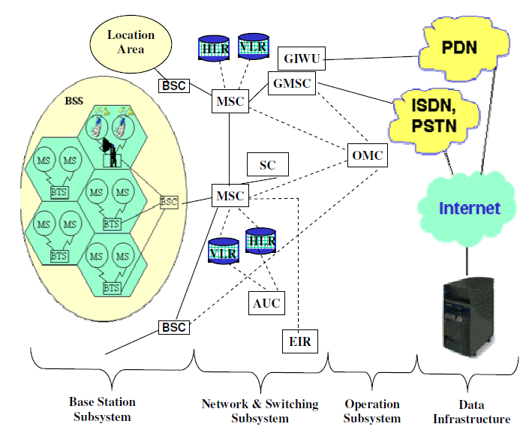
GSM Architecture

Slide 40
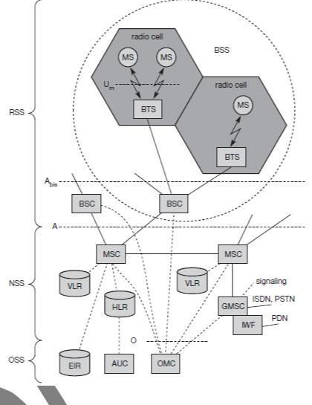
GSM Architecture

Slide 41
GSM Architecture
GSM networks are structured in hierarchical fashion. Figure 1.1 depicts the architecture of a GSM network.
It consists at the minimum one administrative region assigned to an MSC (Mobile Switching Centre).
The administrative region is commonly known as PLMN (Public Land Mobile Network). Each administrative region is subdivided into one or many location area.
One location area consists of many cell groups. Each cell group is assigned to one BSC (Base Station Controller).
Cells are formed by the radio areas covered by a BTS (Base Transceiver Station). Traffic from the mobile station is routed through BTS/BSC to MSC.

Slide 42
GSM Architecture
A GSM network can be divided into four main functional groups. These are:
Mobile Station (MS): This is the device used by an individual. Most of the time, this will be a handphone. However, this could be a portable computer, laptop, palmtop, PDA (Personal Digital Assistant), or other devices as well. A mobile station includes the Mobile Equipment (ME) and the Subscriber Identity Module (SIM).
Base Station Subsystem (BSS): This includes the Base Transceiver Station (BTS) and the Base Station Controller (BSC).
Network and Switching Subsystem (NSS): This includes Mobile Switching Centre (MSC), Home Location Register (HLR), Visitor Location Register (VLR), Equipment Identity Register (EIR), and the Authentication Centre (AUC).
Operation and Support Subsystem (OSS): This includes the Operation and Maintenance Centre (OMC).

Slide 43
GSM Architecture
The functionalities of MSC together with HLR and VLR provide the call-routing and roaming capabilities of GSM.
HLR stores information of subscribers related to service capability, authentication, and accounting. Every network has at least one HLR.
Home network maintains the accounting information and charges the subscriber for all services offered by the home network or any foreign network during roaming. This is why home network is also called Subscription network.
VLR on the contrary, can be considered as a cache containing some essential information copied from the HLR.
VLR moves with the subscriber and used by the serving network to locate the MS and route the call.

Slide 44
GSM Architecture
Network Switching Subsystem: The NSS is responsible for performing call processing and subscriber related functions.
The switching system includes the following functional units:
Home location register (HLR):
It is a database used for storage and management of subscriptions. HLR stores permanent data about subscribers, including a subscribers service profile, location information and activity status.
When an individual buys a subscription from the PCS provider, he or she is registered in the HLR of that operator.

Slide 45
GSM Architecture
Visitor location register (VLR):
It is a database that contains temporary information about subscribers that is needed by the MSC in order to service visiting subscribers.
VLR is always integrated with the MSC. When a MS roams into a new MSC area, the VLR connected to that MSC will request data about the mobile station from the HLR.
Later if the mobile station needs to make a call, VLR will be having all the information needed for call setup.
Authentication center (AUC):
A unit called the AUC provides authentication and encryption parameters that verify the users identity and ensure the confidentiality of each call.

Slide 46
GSM Architecture
Equipment identity register (EIR):
It is a database that contains information about the identity of mobile equipment that prevents calls from stolen, unauthorized or defective mobile stations.
Mobile switching centre (MSC):
The MSC performs the telephony switching functions of the system.
It controls calls to and from other telephone and data systems.

Slide 47
GSM Architecture
Radio Subsystem (RSS):
The radio subsystem (RSS) comprises all radio specific entities, i.e., the mobile stations (MS) and the base station subsystem (BSS).
The figure shows the connection between the RSS and the NSS via the A interface (solid lines) and the connection to the OSS via the O interface (dashed lines).
Base station subsystem (BSS): A GSM network comprises many BSSs, each controlled by a base station controller (BSC).
The BSS performs all functions necessary to maintain radio connections to an MS, coding/decoding of voice, and rate adaptation to/from the wireless network part.
Besides a BSC, the BSS contains several BTSs.

Slide 48
GSM Architecture
Base station controllers (BSC):
The BSC provides all the control functions and physical links between the MSC and BTS.
It is a high capacity switch that provides functions such as handover, cell configuration data, and control of radio frequency (RF) power levels in BTS.
A number of BSC’s are served by and MSC.

Slide 49
GSM Architecture
Base transceiver station (BTS):
The BTS handles the radio interface to the mobile station.
A BTS can form a radio cell or, using sectorized antennas, several and is connected to MS via the U_{m} interface, and to the BSC via the A_{bis} interface.
The U_{m} interface contains all the mechanisms necessary for wireless transmission (TDMA, FDMA etc.).
The BTS is the radio equipment (transceivers and antennas) needed to service each cell in the network.
A group of BTS s are controlled by an BSC.

Slide 50
GSM Architecture
Operation and Support system:
The operations and maintenance center (OMC) is connected to all equipment in the switching system and to the BSC.
Implementation of OMC is called operation and support system (OSS).
The OSS is the functional entity from which the network operator monitors and controls the system.
The purpose of OSS is to offer the customer cost-effective support for centralized, regional and local operational and maintenance activities that are required for a GSM network.
OSS provides a network overview and allows engineers to monitor, diagnose and troubleshoot every aspect of the GSM network.

Slide 51
GSM Architecture
The mobile station (MS) consists of the mobile equipment (the terminal) and a smart card called the Subscriber Identity Module (SIM).
The SIM provides personal mobility, so that the user can have access to subscribed services irrespective of a specific terminal.
By inserting the SIM card into another GSM terminal, the user is able to receive calls at that terminal, make calls from that terminal, and receive other subscribed services.
The mobile equipment is uniquely identified by the International Mobile Equipment Identity (IMEI).
The SIM card contains the International Mobile Subscriber Identity (IMSI) used to identify the subscriber to the system, a secret key for authentication, and other information.
The IMEI and the IMSI are independent, thereby allowing personal mobility.
The SIM card may be protected against unauthorized use by a password or personal identity number.

Slide 52
Radio Interface
The most interesting interface in a GSM system is Um, the radio interface, as it comprises various multiplexing and media access mechanisms.
GSM implements SDMA using cells with BTS and assigns an MS to a BTS.

Slide 53
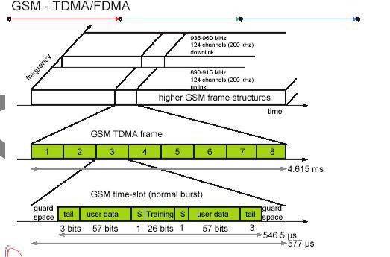
Radio Interface

Slide 54
Radio Interface
Each of the 248 channels is additionally separated in time via a GSM TDMA frame, i.e., each 200 kHz carrier is subdivided into frames that are repeated continuously.
The duration of a frame is 4.615 ms. A frame is again subdivided into 8 GSM time slots, where each slot represents a physical TDM channel and lasts for 577 μs.
Each TDM channel occupies the 200 kHz carrier for 577 μs every 4.615 ms.
Data is transmitted in small portions, called bursts.
The following figure shows a so called normal burst as used for data transmission inside a time slot. As shown, the burst is only 546.5 μs long and contains 148 bits.
The remaining 30.5 μs are used as guard space to avoid overlapping with other bursts due to different path delays and to give the transmitter time to turn on and off.

Slide 55
Radio Interface
The first and last three bits of a normal burst (tail) are all set to 0 and can be used to enhance the receiver performance.
The training sequence in the middle of a slot is used to adapt the parameters of the receiver to the current path propagation characteristics and to select the strongest signal in case of multi-path propagation.
A flag S indicates whether the data field contains user or network control data.

Slide 56
Handover
Cellular systems require handover procedures, as single cells do not cover the whole service area.
However, a handover should not cause a cut-off, also called call drop.
GSM aims at maximum handover duration of 60 ms.
There are two basic reasons for a handover:
  1. The mobile station moves out of the range of a BTS, decreasing the received signal level increasing the error rate thereby diminishing the quality of the radio link.
  2. Handover may be due to load balancing, when an MSC/BSC decides the traffic is too high in one cell and shifts some MS to other cells with a lower load.
The four possible handover scenarios of GSM are shown below:

Slide 57
4 types of handover
1
2
3
4
MS
MS
MS
MS
BTS
BTS
BTS
BTS
BSC
BSC
BSC
MSC
MSC

Slide 58
Handover
Intra-cell handover: Within a cell, narrow-band interference could make transmission at a certain frequency impossible. The BSC could then decide to change the carrier frequency (scenario 1).
Inter-cell, intra-BSC handover: This is a typical handover scenario. The mobile station moves from one cell to another, but stays within the control of the same BSC. The BSC then performs a handover, assigns a new radio channel in the new cell and releases the old one (scenario 2).
Inter-BSC, intra-MSC handover: As a BSC only controls a limited number of cells; GSM also has to perform handovers between cells controlled by different BSCs. This handover then has to be controlled by the MSC (scenario 3).
Inter MSC handover: A handover could be required between two cells belonging to different MSCs. Now both MSCs perform the handover together (scenario 4).

Slide 59
Handover
To provide all the necessary information for a handover due to a weak link, MS and BTS both perform periodic measurements of the downlink and uplink quality respectively.
Measurement reports are sent by the MS about every half-second and contain the quality of the current link used for transmission as well as the quality of certain channels in neighboring cells (the BCCHs).

Slide 60
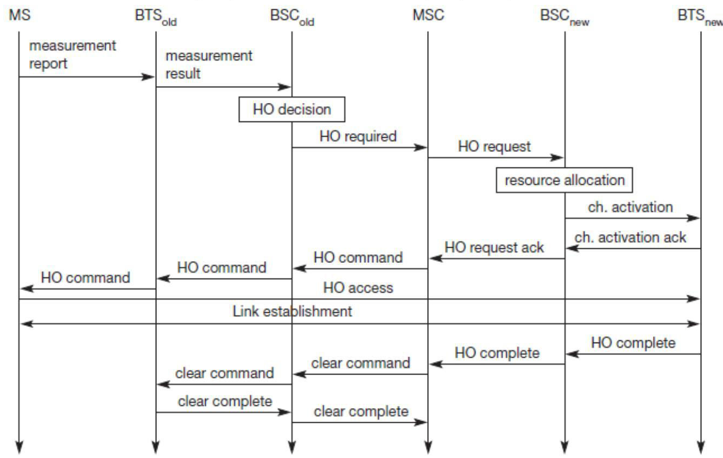
Intra-MSC handover

Slide 61
Security
GSM offers several security services using confidential information stored in the AuC and in the individual SIM. The SIM stores personal, secret data and is protected with a PIN against unauthorized use.
Three algorithms have been specified to provide security services in GSM.
Algorithm A3 is used for authentication, A5 for encryption, and A8 for the generation of a cipher key.
The various security services offered by GSM are:
Access control and authentication: The first step includes the authentication of a valid user for the SIM. The user needs a secret PIN to access the SIM. The next step is the subscriber authentication.

Slide 62
Security
Confidentiality: All user-related data is encrypted. After authentication, BTS and MS apply encryption to voice, data, and signaling.
Anonymity: To provide user anonymity, all data is encrypted before transmission, and user identifiers are not used over the air. Instead, GSM transmits a temporary identifier (TMSI), which is newly assigned by the VLR after each location update. Additionally, the VLR can change the TMSI at any time.

Slide 63
Short Message Service (SMS)
SMS allows sending and receiving of text messages to, and from, mobile stations.
It is called short message as an SMS is limited to 160 characters of English text of 7 bits character (ASCII character), or 140 octets of 8 bits character (some European languages or binary data).
SMS can also be used for 70 characters of Unicode message (Hindi, Chinese Arabic, or other Asian languages).
Service Centre (SC) acts as the message switch for SMS. In some literatures, SC is referred as Short Message Service Centre (SMSC) or SMS Controller (SMSC).

Slide 64
Short Message Service (SMS)
Cellular operators and device manufacturers sometime call an SC as Message Centre (MC).
SC works as the store and forward switching system for SMS messages.
In case of a voice call, while roaming, the MSC in the foreign network (serving network) is used for switching of the outgoing voice call.
On contrary, for SMS switching, the SC of the foreign network is never used.
In GSM, SMS is used for the purpose of cell broadcast as well. SMS has also been in use for applications and information services in many verticals.

Slide 65
General Packet Radio Service

Slide 66
GPRS
GPRS is a Mobile Data Service available to users of GSM and IS-136 mobile phones.
It provides packet data transfer from 9.6 to 171 kbps.
The GPRS specifications are written by (ETSI), but now by the 3rd Generation Partnership Project (3GPP)
GPRS systems support both X.25 and IP network layer protocols.

Slide 67
Advantages
GPRS is packet-switched and multiple users share the same transmission channel for transmitting the data.
Benefits:
  The always online feature
  An upgrade to existing systems
  Higher Data Rate
  Easy Billing

Slide 68
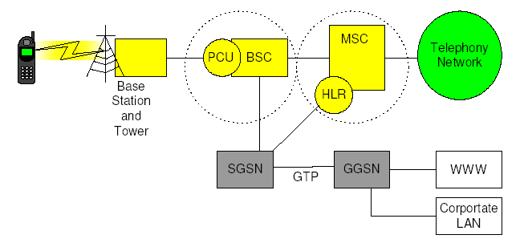
Simple Overview

Slide 69
Mobility Management
The operation of the GPRS is partly independent of the GSM network, but for efficiency and optimized use of GSM resources some network elements are shared.
A mobile station has three states in the GPRS system:
  Idle
  Standby
  Active
Gateway GPRS support node (GGSN):
It handles interaction with the external data network and routes external data packets to/from the SGSN
Serving GPRS support node (SGSN):
It handles the data routing, mobility management, authentication, charging functions.

Slide 70
Mobility Management
Data is transmitted between a mobile station and the GPRS
network only when the mobile station is in the active state.
In the active state, the SGSN knows the cell location of the mobile station.
In the standby state, the location of the station is known only as to which routing area it is in.
In the idle state, the mobile station does not have a logical
GPRS context activated or any Packet-Switched Public Data Network addresses allocated, The MS can receive only those multicast messages that can be received by any GPRS mobile station.

Slide 71
Basic Processes
The basic processes used in GPRS networks:
Attach process: Process by which the MS attaches (i.e, connects) to the SGSN in a GPRS network
Authentication process: Process by which the SGSN authenticates the mobile subscriber
PDP activation process: Process by which a user session is established between the MS and the destination network

Slide 72
Basic Processes
Detach process: Process by which the MS detaches (i.e., disconnects) from the SGSN in the GPRS network
Network-initiated PDP request for static IP address: Process by which a call from the packet data network reaches the MS using a static IP address
Network-initiated PDP request for dynamic IP address: Process by which a call from the packet data network reaches the MS using a dynamic IP address

Slide 73
Classes of GPRS terminal Equipments
Class A:
Class A terminals can handle packet data and voice at the same time. In other words, we need two transceivers because the handset has to send and/or receive data and voice at the same time. This situation makes class A terminals significantly more expensive to manufacture than class B and C terminals.
Class B:
Class B terminals can handle both packet data and voice, but not at the same time. In other words, you can use the same transceiver for both, keeping the cost of the terminals down.
In practice, the GPRS session (like WAP browsing, file transfer, and so on) is suspended when a GSM voice call is started.
Class C:
Class C terminals can only handle either voice or data.

